Slide 1
Traditional Care of Terrazzo Flooring
NTMA Technical Seminar 2012
Presented by:
John D’Agnolo
Bob Michielutti
Mike Grissom

Slide 2
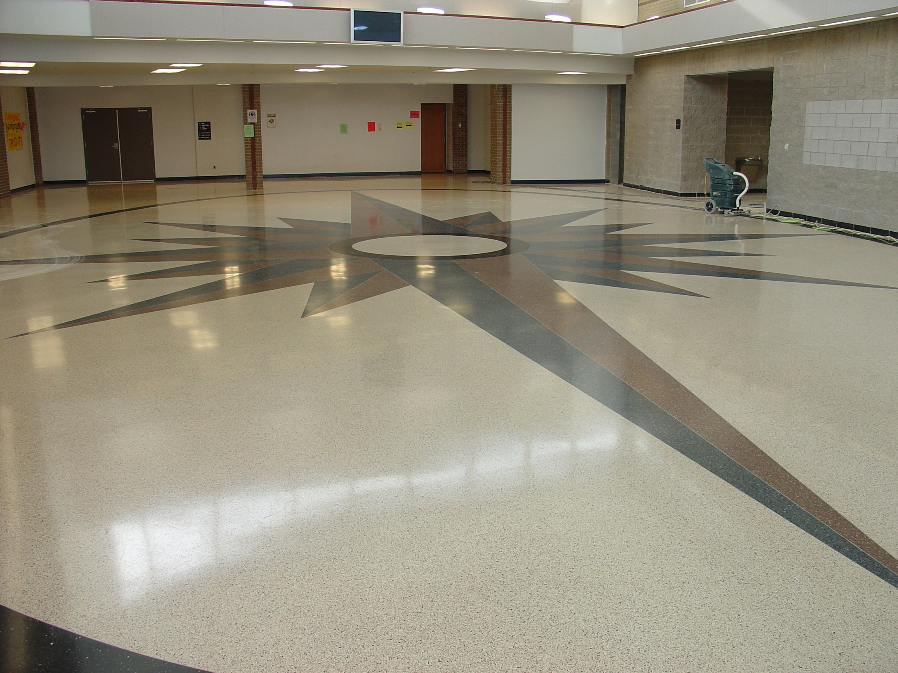

Slide 3
How do I maintain my newly installed Terrazzo floor?
What type of Terrazzo was installed: Cement, Epoxy, Rustic???
Both Cement and Epoxy (in General ) can be maintained the same way.
We will leave Rustic Terrazzo maintenance for another day (See Technical Bulletin #65A-B.

Slide 4
One of the most frequent calls the NTMA office receives is:
“How do I take care of my terrazzo floor”
We, as good terrazzo contractors have the duty to educate the end user on how to
take care of terrazzo flooring.
Terrazzo floors are know to have ease of maintenance, but this should not be interpreted
that NO CARE IS REQUIRED.
It is much easier for an owner to maintain a terrazzo floor that was properly finished
and sealed in the first place.
Damages to the surface due to neglect and abuse must be remedied by the responsible
party. This may mean, stripping, scrubbing and re-apply the original sealer used on the
Terrazzo flooring.

Slide 5
The Tradition method of finishing and maintaining a terrazzo floor is applying a topical sealer/finish/wax.
Prior to any type of successful maintenance program: The Installing Terrazzo contractor
must leave the surface of the terrazzo free of all grind marks, swirl marks. Please see Technical Bulletin # 69.
Once the terrazzo floor is finished to the necessary hone: Traditional 120g to 200g
(Depending on the color of the floor: Black terrazzo may need to be taken to a higher
hone to achieve satisfactory results.)
The terrazzo floor should be scrubbed with a good quality soap to remove any grinding
residue and dust. Rinse floor and pick up rinse water with a wet vacuum.
Once the floor is clean and dry, take your hand and wipe across the floor.
There should be no residue picked up by your hand.
Now you can apply the specified and approved sealer for that project.
Follow the directions for the sealer you are using.

Slide 6
Types of Sealers
Acrylic Polymer Sealer:
Products like: TerraGlaze by Spartan / Plaza™ Plus by Diversey / etc.
Gloss or Matte shine
Owners equate Shiny with Clean (often not the case).
ASTM D 2047-04: Remember, your not walking on the terrazzo but the sealer!!
All Sealers you use or recommend must have a published Slip COF rating of 0.5 or higher as measured by the James Machine.
Wax: Paste Wax – Do not use this on any terrazzo floor
Top Coats: Pro-Shine, Upper Limits by Spartan / Snapback Spray buff by Diversey.
Applied only on top of a base coat of sealer. Will help remove scuffs and black heal marks and restore gloss, however may require more labor.
Solvent Based Sealers: Penetrating Sealers and topical sealers.
May not be able to use in all setting nor is this a “Green Product”. Solvent based sealers have a tendency to discolor with age and presents removal problem for the user, especially when wear patterns develop or discoloration dictates stripping from the surface.
/MC

Slide 7
Penetrating Sealers: Not used on Epoxy terrazzo, can be used on Cement terrazzo
Will protect the marble and cement mix of the terrazzo from staining when terrazzo composition is fully saturated. Will not protect the top surface of the terrazzo floor from scratching and dulling from abrasive grit and grime.
Most, if not all sealers, are permeable. Meaning, water can pass through them over
time. If water can pass through them, then any type of containments can penetrate the
sealer if left on the surface a very long time.
The exception to this is a Aliphatic Urethane.
This type of Sealer is a specialty sealer used in very harsh chemical environments and requires special training and safety precautions to apply.
Many Owners want to see a high sheen or gloss on their floors. It must be understood that safety is a concern in all buildings, so sealers and or topical coatings must have a slip resistance coefficient of friction of 0.5 or higher.

Slide 8
Cleaners
Harsh cleaners can damage terrazzo
Use only neutral products with a PH factor between 7 and 10.
Always follow manufactures written instructions and test product in a non-conspicuous
area of the floor to determine desired results.
Avoid the use of all-purpose cleaners or soaps containing water soluble, inorganic,
or crystallizing salts. THEY WILL DAMAGE THE TERRAZZO OVER TIME
Do not use sweeping compounds that contain oil. Oil based sweeping compounds
are a fire hazard and will penetrate and can permanently stain, discolor the terrazzo
Many sweeping compounds contain sand which is hard to sweep and could abrade
the finish if not removed promptly.

Slide 9
ALWAYS KEEP RINSE WATER, MOPS & PAILS CLEAN!!!!
The use of an auto-scrubber is an excellent method to clean the terrazzo floors.
The auto-scrubber must be fitted with either a Tampico brush or white pads.
No abrasive pads or brushed should be used unless you want to remove the finish
on the terrazzo floor.
Once the floor is cleaned with the neutral cleaning solution, it can be buffed once the
terrazzo floor is dry to bring out the luster of the existing floor finish. Buffing can be
accomplished with a auto-scrubber or “Buffer” fitted with a Tampico brush or White
nylon pad.
Once applied to the terrazzo surface, allow the neutral cleaner time to react to loosen
foreign materials (i.e. dirt). Several minutes should be adequate, but do not allow
solution to dry on the surface.

Slide 10
How often must we sweep or scrub the terrazzo floor?
Dependent upon the amount of foot traffic that moves across the floor daily.
It is normal in most circumstances that DAILY dust mopping be preformed
This action removes not only the dust but also the grit that is tracked into the building.
This grit acts as an abrasive on the hard surface and can cause dulling of the floor finish.
At a minimum, dust mopping must be done daily during months when snow removal salts
and sands are utilized at the entrances of the building.
Daily dust (damp) mopping or sweeping can be accomplished with a yarn-wick brush treated with a sweeping compound formulated for terrazzo. Or the use of a cotton mop
dipped into a diluted neutral cleaning solution, mop rung out so that is leaves no visible
moisture on the terrazzo.
Normally a newly constructed building contains a considerable amount of construction
dust in the air that will eventually deposit itself on the floors. Initially, scrubbing should
be considered twice weekly until the construction dust no longer exists.

Slide 11
Daily Maintenance
Sweep
Damp Mop
Use of an Auto-Scrubber
Hand work stubborn stains and scuffs marks with neutral cleaner diluted in warm water.
Rinse with clean water, change rinsing water often.
Always keep rinse water, mops & pails CLEAN!!!
May need to be done twice daily or more when de-icing and salt agents are used and
present.

Slide 12
Weekly Maintenance
Damp mop lightly soiled floors with neutral cleaner
Heavily soiled floors should be scrubbed with a mechanical buffing machine with
neutral cleaner. Mop up residue before it dries with clean water. An auto-scrubber
is very helpful to accomplish this.
Allow to dry and buff with a Tampico brush or white nylon pad.
For floors with a top coat in addition to the sealer; follow the manufactures
written instructions.

Slide 13
Annual Maintenance
If needed, strip all old sealer and dressings from floor.
Use a stripper manufactured by the same maker of the sealer you are using.
Re-seal with sealer; at least two coats should suffice.
Apply top dressing if desired.
If the terrazzo floor becomes dull and unsightly, pitted or heavily scratched, do not
attempt to refinish or restore it by sanding or grinding. This type a damage, abuse or
lack of maintenance requires professional attention.
Have the owner or it’s agent contact a reputable NTMA contractor for course of
corrective action.
In heavy use applications; i.e. Airports, stripping and/or re-sealing may need to done
more often than once a year.

Slide 14
Use only specialized products manufactured for terrazzo flooring.
You can add the following:
Use only specialized products to insure proper maintenance of your terrazzo floors.
The approved sealer used on your terrazzo floor is ___________. Please reference
the product data on this material for additional information regarding maintenance and protection of the terrazzo floor. Many suppliers with products of proven
reliability that serve the terrazzo trade are members of the NTMA.
For any further information or brand names of maintenance products, please contact
your local NTMA Terrazzo contractor or the Executive Director at the National Terrazzo
and Mosaic Association.

Slide 15
Another note of Frequency of cleaning and success of a maintenance program:
Cleaning cycle should be regulated by the amount of foot traffic the terrazzo
floor receives. Neutral cleaners are designed to react only if a solution of
clean water and cleaner (mixed in accordance to the manufacturer instructions)
is allowed to remain on the floor surface for several minutes. This step provides the
time necessary for the grime dissolving action to take place. Removal of the dirt-laden solution from the surface should be done by squeegee, vacuum or mopping.
Rinse with ample clean water.
It is essential to maintain a clean appearance of the terrazzo floor; water, mops
and other equipment must be clean.
Areas that require EXTRA attention and necessary cleaning and re-application of a protective sealer: Restrooms (especially at urinals). Red wine is highly staining and acidic and requires that it be wiped up ASAP to avoid permanently staining and etching the terrazzo floor.

Slide 16
Alternate method of maintaining terrazzo flooring:
This method can produce a sheen without the application of sealers.
This method is only successfully with a strict and regimented maintenance program
that employees daily and weekly cleaning.
As the terrazzo floors are cleaned with the neutral based cleaner/water solution,
the final mopping picks up the majority of the cleaner, but leaves traces of the cleaner
solution on the surface of the terrazzo. After several such procedures, the
residue of the cleaner can be dry buffed after each washing with a mechanical buffer
fitted with a Tampico brush or White nylon pad, resulting in a higher sheen.
This method will not protect the top surface of the terrazzo from abrasive grit and
grime that may dull and scratch the floor.
This method, all though used successfully years ago, is not widely employed
now.

Slide 17
CUSTODIAN’S GUIDE FOR THE
PROPER MAINTENANCE
OF TERRAZZO
CAUTION: Before deviating from these instructions, contact your local terrazzo contractor for advice.
Always keep rinse water, mops & pails clean!!
DAILY: SWEEP USING A YARN-WICK BRUSH TREATED WITH SWEEPING COMPOUND.
Use a sweeping compound formulated for terrazzo. (Wax-based without any harsh sand) Hand work stubborn stains and scuff marks with neutral cleaner diluted in warm water.
WEEKLY: DAMP MOP LIGHTLY SOILED FLOORS WITH NEUTRAL CLEANER.
Heavily soiled floors should be scrubbed with a mechanical buffing machine and neutral cleaner. Mop up residue before it dries with clean water. An auto-scrubber is very helpful to accomplish this. Allow to dry and buff with a dry Tampico brush or white nylon pad. (For floors requiring a high luster, apply a thin coat of specially prepared finishing material and buff to bring up sheen.
NOTE: ONCE APPLIED TO THE TERRAZZO SURFACE, ALLOW YOUR NEUTRAL CLEANER TIME TO REACT TO LOOSEN FOREIGN MATERIALS (I.E. DIRT). SEVERAL MINUTES SHOULD BE ADEQUATE, BUT DO NOT ALLOW SOLUTION TO DRY ON THE SURFACE.
ANNUALLY: STRIP ALL OLD DRESSING AND SEALER. RE-SEAL CLEAN FLOOR.
If the floor becomes dull and unsightly, do not attempt to refinish or restore it by sanding or grinding. This requires professional attention. Call Michielutti Bros., Inc. @ 586-776-4990 (mbi@michbros.com) or the National Terrazzo and Mosaic Association @ 1-800-323-9736. Please see the attached product data for the sealer that was applied when new.
USE ONLY specialized products produced to insure proper maintenance of your Terrazzo floors. The approved sealer used on your terrazzo floor is Terra Glaze by Spartan. Please reference the product data on this material for additional information regarding maintenance and protection of the terrazzo floor. Many suppliers with products of proven reliability that serve the terrazzo trade are members of the NTMA.
For any further information or brand names of maintenance products, please contact your local terrazzo contractor or the Executive Director at the National Terrazzo and Mosaic Association, Inc.

Slide 18
DO’S AND DON’TS FOR TERRAZZO FLOOR CARE
HELPFUL TIPS FOR TERRAZZO MAINTENANCE: Your terrazzo floor has a minimum of 70% marble chip density on the surface. It has been ground, polished, and sealed with an acrylic, polymer-based terrazzo sealer. This coating protects your surface from water-borne stains, but it is essential that no spillage be ignored and allowed to soak and dry onto the floor. Good house-keeping procedures require that your floor remain clean. By following proper care procedures, your terrazzo floor should provide you with maintenance ease and a lifetime of performance that remains aesthetically beautiful. Before you commence with a maintenance program or purchase materials, it is best to understand this flooring system by reading details of care available from your terrazzo contractor or the NTMA.
DO’S
DO ask your installing terrazzo contractor to recommend the proper neutral cleaner and sealer to be used on your floor. (Recommended neutral cleaners: (Fill IN)
DO dust mop your floors daily, this not only picks up the dust, but also the grit tracked into your building. The grit acts as an abrasive on your hard surface floor.
DO scrub your floors a minimum of three times a week where a new terrazzo floor has been installed for the initial two to three months as the construction dust is still in the air and will eventually be deposited on your floor. Also, this schedule should be maintained during times when snow removal salts are utilized at the entrances of the building. After this period, once per week, dependent on the amount of foot traffic, should keep your floor clean in appearance. Always rinse your floors well to prevent a build-up of residue of cleaner that could become slippery. The use of an auto-scrubber fitted with WHITE nylon pads can be used and is an effective means of maintaining your terrazzo floors.
DO seal your floors with a water-based acrylic sealer in accordance with the manufacturer’s instructions. Normally a new floor requires two or more coats, which should provide a good sheen for a period of 45 to 60 days, before it would need additional coats. Sealer should be classified by Underwriters Laboratories and be slip resistant with a minimum C.O.F. rating of 0.5 or higher. Terra Glaze by Spartan Products has been applied to your terrazzo floor. Please read the accompanying literature about this product and how to maintain this sealer.
DO use maintenance products designed for epoxy terrazzo.
DO allow your neutral cleaner, once applied to the terrazzo surface, time to react as designed to loosen foreign matter. Several minutes should be adequate, but DO NOT allow the solution to dry on the surface.

Slide 19
DON’TS
DON’T use purely surface waxes, or “good for everything” sealers. These products may lead to unpredictable results.
DON’T use all purpose cleaners of soaps containing water soluble inorganic or crystallizing salts, harmful alkali or acids. Use of such products could prove harmful to your terrazzo floor.
DON’T use cheap cleaners or sealers as the majority of your maintenance costs is labor.
DON’T try miracle cleaners or sealers on your floor without getting an opinion on such products from your local terrazzo contractor or the NTMA.
NOTE: IN THE EVENT THAT YOUR FLOORS GET BADLY SOILED, CONSULT WITH A MEMBER OF THE NATIONAL TERRAZZO AND MOSIAC ASSOICATIONS BEFORE PROCEEDING TO ATTEMPT TO CLEAN!
ALWAYS KEEP RINSE WATER, MOPS AND PAILS CLEAN!

Slide 20
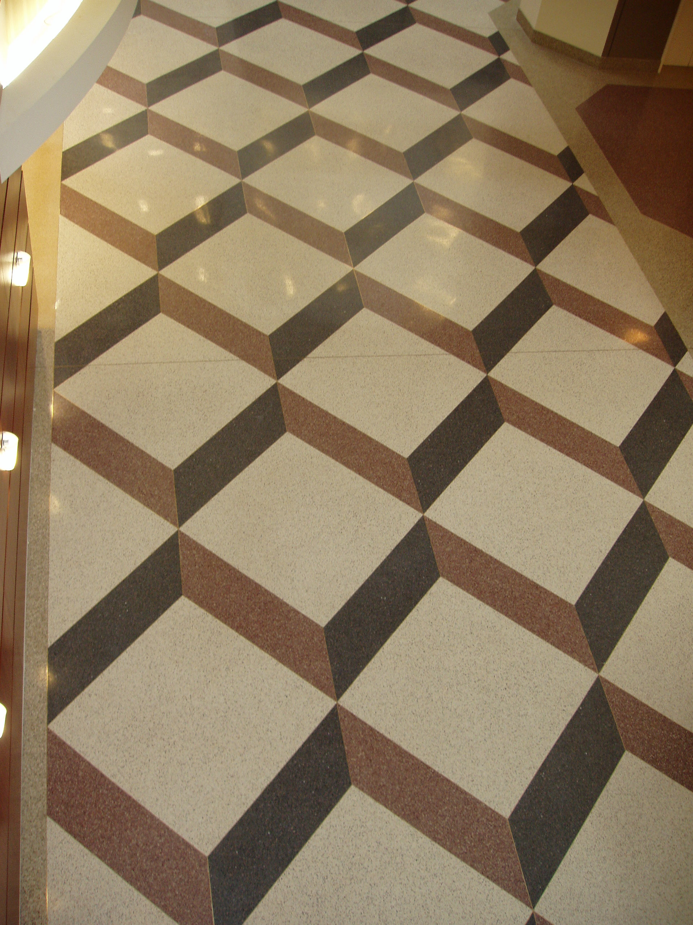

Slide 21
Maintenance Guide for Terrazzo Flooring Using Diversey Products
Caution:
Refer to MSDS for proper use of PPE (Personal Protective Equipment)
Always use caution tape and wet floor signs when performing any wet maintenance
Refer to label directions for detailed use instructions of Diversey Sealers, Finishes, Strippers, and cleaners.
Initial Maintenance
1. Sweep and/or dust mop the floor to remove all dirt or grit.
Scrub floor using Prominence @ recommended dilution rate. Use a blue or green pad.
3. Pick up cleaner solution with wet dry vac or auto scrubber.
Rinse floor thoroughly, and allow to completely dry.
Apply Floor Sealer/Finish
1. Post “Wet floor signs”. It has also become common practice to use caution tape and barricades.
2. After the floor has been cleaned or stripped, rinsed, and allowed to dry, apply 4 medium (2,000-2500 sq. ft. per-gallon) coats of Plaza Plus, Carefree, or Carefree Matte Sealer Finish to the floor depending on desired gloss and maintenance. (Note you may only get 1700 sq. ft. per gallon on the first coat depending on the porosity of the floor.) Apply 4 coats of desired Diversey Floor Sealer/Finish. Apply no more than 4 coats in a 24-hour period. Additional 2-4 coats may be applied on the following day, after thoroughly cleaning floor.
3. Allow 10-15 minutes after finish is dry to the touch before applying additional coats (usually 45-60 minutes are required between coats).
TM/MC
TM/MC

Slide 22
If a different Diversey Finish is required:
Use Plaza Plus or Iron Stone to seal the floor and ensure adhesion (2 coats). Then apply the Diversey finish of your choice based on your particular requirements for appearance, durability, and maintenance. Apply no more than 4 coats of sealer and or finish in a 24-hour period. Additional 2-4 coats may be applied on the following day, after thoroughly cleaning floor.
Daily Maintenance
Sweep and/or dust mop the floor daily to remove surface dirt.
Post “wet floor” signs.
Auto scrub floor using Prominence according to label directions. Use red pad for daily maintenance.
TM/MC
TM/MC
TM/MC

Slide 23
Interim Maintenance
Spray Buffing
Use Snapback Spray Buff to remove scuffs and restore gloss in a conventional maintenance system. Using a 175 RPM swing machine equipped with a red buffing pad, spray a light mist to a small area and buff. Be sure the floor is clean and dry before starting this procedure. (See Snap Back Spray Buff label directions for detailed use instructions.)
TM/MC

Slide 24
Terrazzo Maintenance Methods
Polished Terrazzo:
High initial installation cost and no chemical protection. This program can also be expensive to repair. Considered by some to be the best “natural” look for stone floors. This program may incorporate a penetrating seal to achieve some protection without compromising the natural look.
Sealed and finished with acrylic floor finish UHS program:
This can have higher gloss than a natural polished floor. It also adds chemical protection. UHS finishes should be burnished often to maintain the look. Maintenance depends on desired gloss level.
Polished and coated with “Shield” type product:
This is somewhere between the Bare Polished and coated floors. It offers some protection and a high level of gloss and appearance. High initial labor cost to install this kind of program but cheaper than a coated UHS floor care system to maintain.
Sealed with Penetrating Sealer- Inexpensive and natural look gives some protection usually must clean spills within 30-45 minutes.
Use of a Matte or Gloss chemical resistant coatings: JonCrete Matte best chemical protection and low maintenance. Joncrete Gloss- same chemical protection as the Matte however may require more maintenance to maintain gloss.

Slide 25
Informative Bulletin
Market Segment:
Building Service Contractors, Education, Food Processing, Agricultural, General Manufacturing, Government, Healthcare, Lodging, Hospitality, Other, Retail
Product:
TERRA GLAZE®
Product Number:
5810
Main Body:
ACRYLIC POLYMER TERRAZZO SEAL
PRODUCT DESCRIPTION: TERRA GLAZE is an acrylic polymer seal developed exclusively for use on terrazzo.
Of all the traditional hard floor surfaces, perhaps the most popular and expensive is terrazzo. Terrazzo is constructed of marble chips set in a mixture of portland cement. While the natural terrazzo surface is highly polished, due to the porosity of the cement ingredient, a sealer is required to protect the floor from penetration of spills, wear, tear, and damage from heavy traffic. TERRA GLAZE was developed to fill these specific maintenance requirements and offers a number of unique features and benefits:

Slide 26
HIGH GLOSS/HIGH SOLIDS: A 25% solids metal interlock formulation, just one coat of TERRA GLAZE conditions, seals, and protects the natural beauty of terrazzo. 32.5% total solids produces a gloss normally only achieved with two or three coats of ordinary nonresilient seals.
DURABLE: The backbone of the TERRA GLAZE formulation is a controlled blend of monomers which enhance both the cohesive strength of the finish and its ability to adhere to the substrate. Once applied, TERRA GLAZE becomes a hard, tough seal that combats terrazzo's inherent susceptibility to damage and deterioration due to abrasion, scratching, scuffing, and wear.

Slide 27
LOW BUDGET MAINTENANCE: Since the initial installation cost of terrazzo is high when compared with most floorings, there is great interest in low budget maintenance programs which will maintain the beauty of terrazzo while extending its life span. TERRA GLAZE saves the extensive time and labor usually associated with the maintenance of a terrazzo surface. The formula's one-coat and quick-drying features reduce costly downtime and inconvenience, resulting in labor savings.
NON-YELLOWING: TERRA GLAZE is a milk-white emulsion formulation containing no ingredients that will yellow, distort, diminish, or discolor terrazzo surfaces.

Slide 28
While TERRA GLAZE may be used alone, additional protection and added high gloss can be obtained when used in conjunction with a Spartan metal interlock floor finish. Depending upon the user's equipment, we recommend the following for ultimate protection, gloss, and appearance as well as time and labor savings:
High Speed Machines 1000 and up | Ultra High-Speed Machines 2000 and up
1 coat of TERRA GLAZE 2 coats of Pro-Shine Dry buff or use Spartan Spraybuff with high-speed machines | 1 coat of TERRA GLAZE 2 coats of Upper Limits Dry buff or use Super Spraybuff

Slide 29
HOW TO APPLY:
Wet floors may be slippery. Prevent pedestrian traffic with signs or barricades.
1. Completely strip the terrazzo floor of all seal, wax, and finish.
Before applying TERRA GLAZE make certain the floor is clean and dry. Loose dirt, stripper residue, or dampness will keep TERRA GLAZE from penetrating and bonding to the floor.
3. If the areas to be sealed are smaller than 6' x 6', use a lamb's wool wax applicator.
When sealing larger areas, use a wax and seal mop, rayon mop, or a lint-free cotton mop to apply TERRA GLAZE.
5. Pour TERRA GLAZE into a lined mop bucket with wringer.
Saturate the clean mop with TERRA GLAZE and wring out the lower half or two-thirds until it no longer drips.
7. Apply TERRA GLAZE by keeping the moist mop head flat on the floor. The tail of the mop will
spread the TERRA GLAZE uniformly.
Re-saturate the mop frequently so that the TERRA GLAZE will not spread to thinly or set up too quickly.
9. If the mop becomes dry it will cause streaking.
In ideal weather conditions, TERRA GLAZE should dry within 20 to 30 minutes. After it is dry to the touch, a second coat of TERRA GLAZE or, using a clean mop head, a first coat of On an' On, Pro-Shine, Upper Limits or Sunny Side may be applied.
11. Never use the TERRA GLAZE mop head for applying one of Spartan's floor finishes.

Slide 30
PACKAGING: TERRA GLAZE is packaged in The Big Kid, 330-gallon disposable tote; recyclable HDPE (High Density Polyethylene) 55, 30, and 15-gallon drums; 5-gallon pails; and gallons, four per case. Label copy is available in English and Spanish.
GUARANTEE: Spartan's modern manufacturing and laboratory control insure uniform quality. If dissatisfied with performance of product, any unused portion may be returned for credit within one year of the date of manufacture. Use product as directed and read all precautionary statements.
Some materials may require special handling or application. Please refer to the appropriate Material Safety Data
Sheet, literature and label.

