Slide 1
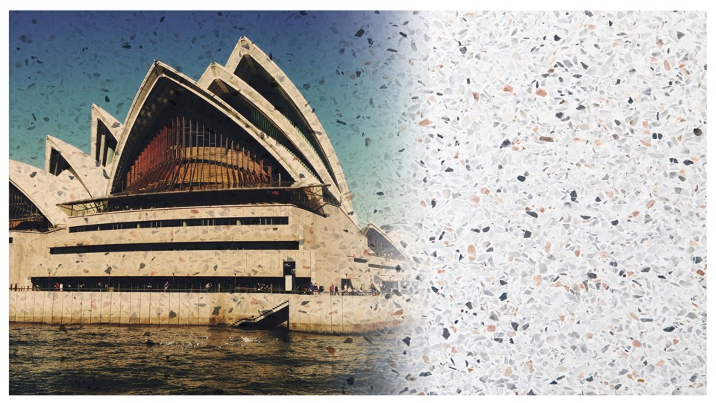
Terrazzo Australia Training & Skills
Presented by Joseph Bagnara
LBAW, Adv Dip Mng, Dip Prgt Mng, Dip Interpreting (LOTE)
PSI Pavements

Slide 2
Introduction – PSI Pavements
We specialise in the art and science of terrazzo pavement construction
Leaders in the field
Experienced in terrazzo pavement construction
Advocates for standards and legislations
Master Artisans in the Pavement Industry

Slide 3
Introduction - Terrazzo
Terrazzo is a manufactured composite of natural marble chips with durable aggregates set in a cement matrix with added colour. The marble chips can be selected from a wide range of colours in practically any colour of cement matrix to create any type of effect. The terrazzo aggregate and marble chips surface is polished after the matrix has set.

Slide 4
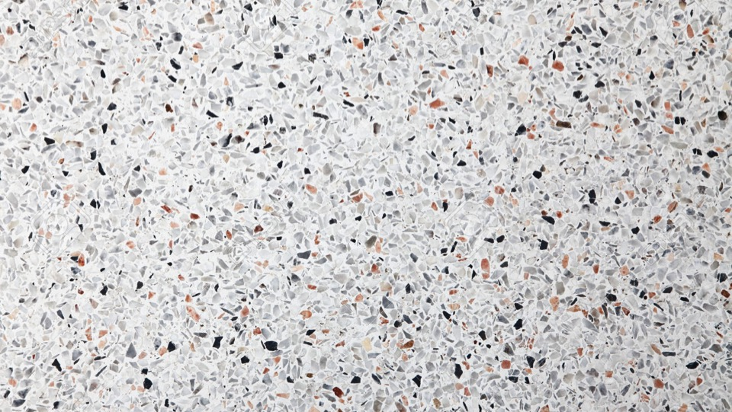
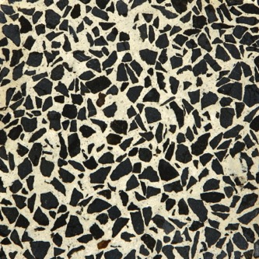
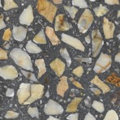
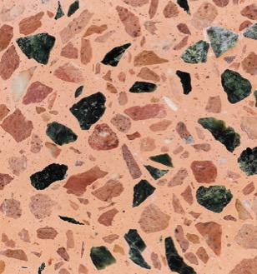
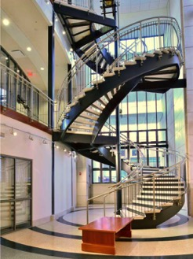
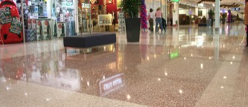

Slide 5
Introduction - Terrazzo
The art of terrazzo flooring has its origins in Italy with terrazzo being a municipality in the Province of Verona. The history of terrazzo flooring is long, with Italian craftsmen establishing themselves as leaders and artisans thousands of years ago. This depth of history is evidenced with archaeologists using the term “terrazzo” to describe the floors of early Neolithic buildings between 9000-8000 BC. The Terrazzo was created by Venetian construction workers as a low cost flooring material. Italian terrazzo workers respect the creativity of the product and have a strong dedication to issues of quality. The Italians had also mastered the art manufacturing and placing of terrazzo tiles.

Slide 6
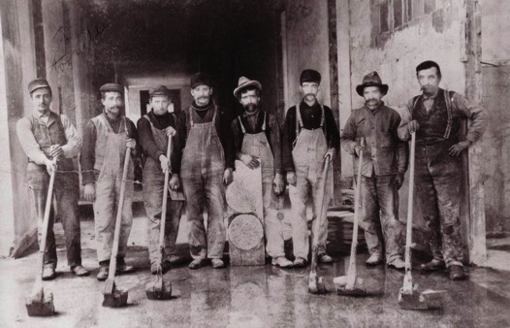
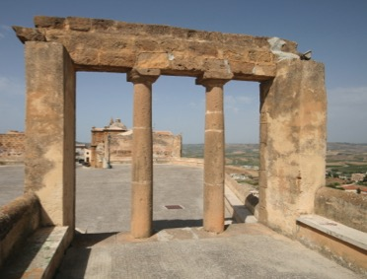
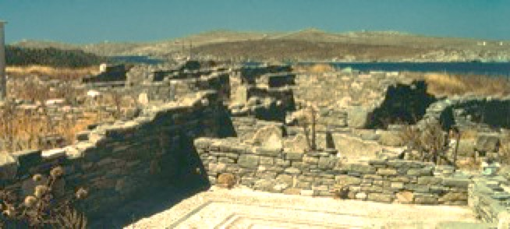

Slide 7
Introduction - Terrazzo
The most extensive use of terrazzo is for floors, whether in situ or in tiles. Skirtings, partitions, staircases and other pre-cast units can also be made of terrazzo. The Terrazzo is mainly used internally and externally. It can be found in supermarkets, railway stations, airports, hospitals, reception areas, bakeries and public and private foyers and buildings. What makes terrazzo unique is the excellent craftsman ship and understanding of the materials used, its longevity and its hygiene qualities as a superior flooring material.

Slide 8
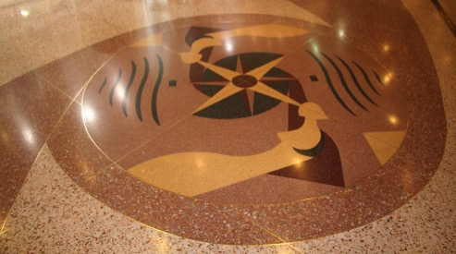
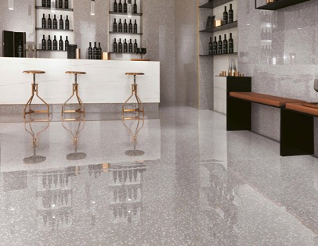
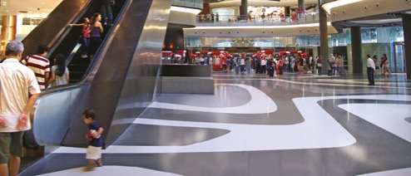
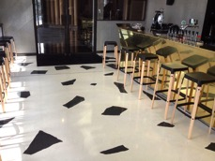
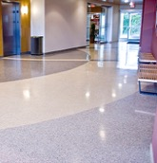

Slide 9
Introduction - Terrazzo
Terrazzo is a high quality, durable product which is hygienic, easy to keep clean and can be used in most heavy duty internal and external areas.
Terrazzo is:
• extremely hard wearing
• easy to keep clean and maintain
• attractive in appearance
• flexible, in that it can be designed to be in keeping with other architectural
buildings and colour schemes
• hygienic, suitable for some areas of food preparation,
• manufactured to a stringent quality and safety standards
• cost-effective-it will out live most other types of hard flooring

Slide 10
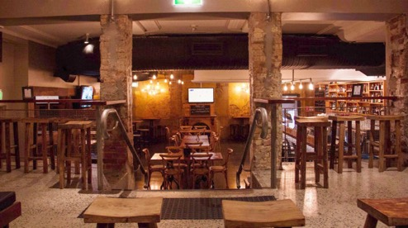
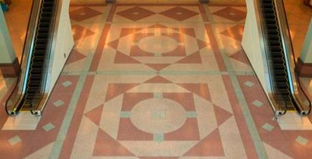
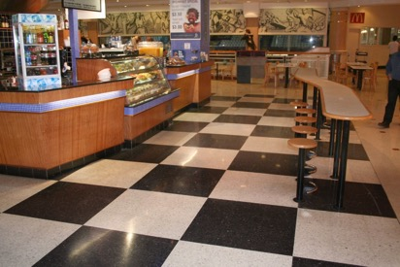
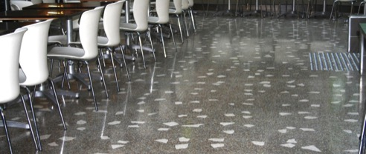

Slide 11
Introduction - Terrazzo
While there is some manufacturing of terrazzo tiles occurring in Australia at present, there is a lack of understanding in the placing and finishing of terrazzo a pavement in tile form, or in particular, terrazzo in situ.
Currently in the industry there are only a small number of people who can successfully complete a pavement to a high quality standard. The number of operatives in Australia working in the industry is limited. Most of the operatives tend to work independently or comprise of small groups of trades persons within a company.

Slide 12
History of Terrazzo in Australia
Terrazzo was traditionally used in Australia in the early 1930s as an interior pavement in bathrooms, laundries, toilets and verandahs in residential homes. Around the same time terrazzo was also used as partitions in public toilets and stairways in commercial buildings. Terrazzo tiles were also used as exterior cladding for commercial buildings in major cities of Australia.
Terrazzo started out as the “poor “man’s flooring but as techniques, machinery and technology evolved terrazzo floors became a unique and “high class” or a product that only the affluent could afford.

Slide 13
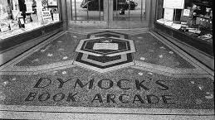
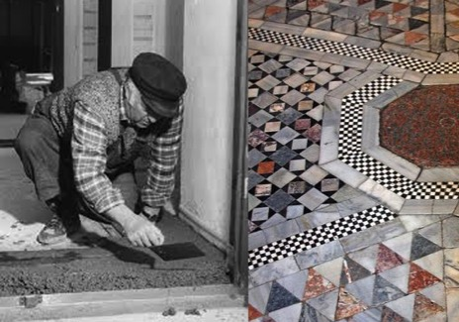
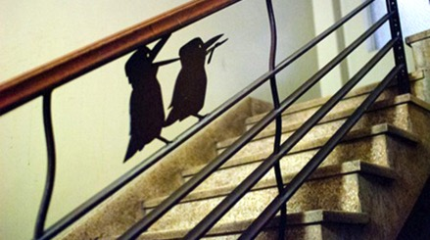

Slide 14
Terrazzo in Australia
In the beginning, terrazzo was placed and finished with basic equipment and was very laborious to construct. Due to the labour intensive techniques required, floors would take many days to complete. Today with machinery and technology, terrazzo floors are easier to construct and are of better quality.
When the migrant Italian population began arriving in Australia over 55 years ago they brought with them the many skills associated with the craft of terrazzo. Over the next 55 years terrazzo was introduced as the pavement for interior flooring and for decorating and embellishing houses.

Slide 15
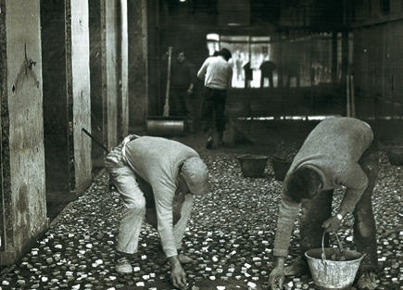
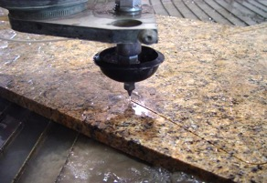
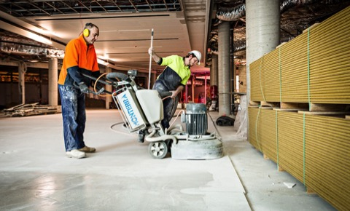
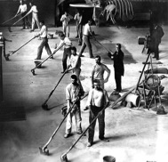

Slide 16
Terrazzo in Australia
In Australia today there is currently no formal training available in the National Training System. There is no training at diploma or certificate level that refers to terrazzo in detail whether in situ or in tile form. As a consequence there is no formal accredited training or an institution where one can be trained to design, select, place, finish and polish terrazzo to a required building standard and hence there are few people who have the knowledge and skill to complete a terrazzo pavement to a high quality standard.

Slide 17
Terrazzo in Australia
In addition, as the ceramic tile was introduced into the marketplace in Australia as an alternative pavement, terrazzo diminished as the preferred interior and exterior pavement and hence terrazzo diminished as an industry. The consequence of this is reflected by the existing heritage terrazzo pavements not being restored but rather replaced with ceramic tiles or other pavement finishes such as polished concrete.

Slide 18
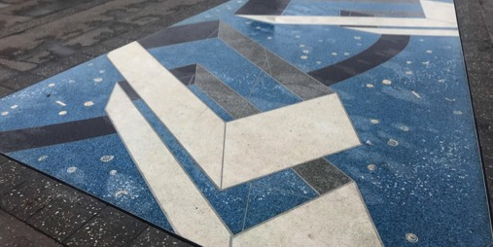
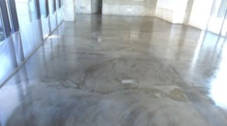
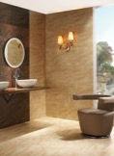
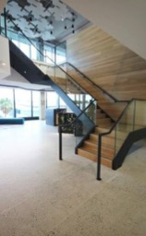
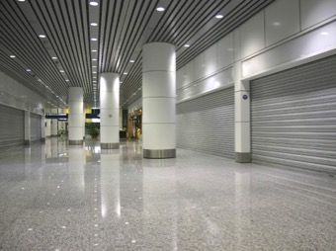

Slide 19
Terrazzo in Australia
Subsequently, the Australian building and construction industry has skills deficiency amongst skilled tradespeople when it comes to the restoration and construction of terrazzo pavements. Skill deficiencies in terrazzo are significant in Australia with no national accredited course on offer at any Australian University or TAFE institute within this field.

Slide 20
Terrazzo in Australia
There is a flow on effect for architectural designers in so far that, in the main, they cannot design, nor provide specifications in this traditional trade and crafts for new builds or restoration work. As a consequence designers have accommodated the lack of skilled craftsmen with alternate products and other solutions. The flow on effect continues into the sphere of heritage activities with the lack of skilled tradespeople impacting on the quality and conservation solutions available.

Slide 21
Terrazzo in Australia
This small number of existing heritage terrazzo pavements in Australia are being demolished rather than be restored due to the shortage of skilled people in the industry who have the knowledge and expertise in this area. By addressing the deficiency of skills through established formal training programs and through the recognition of its inherent positive qualities terrazzo pavements should, once again, become increasingly specified in Australia by designers. The introduction of polished concrete to Australia has made people and designers look at Terrazzo once again as their preferred pavement.
This recognition combined with the availability of trained artisans could in turn encourage the ongoing use of the product and would return terrazzo as a popular flooring material, boosting the manufacturing sector to produce more products.

Slide 22
Terrazzo Training Program Proposal

Slide 23
Training Program Proposal
Certificate III in Terrazzo Pavements
This qualification provides a trade outcome in terrazzo pavements and structures for residential and commercial construction work.
Occupational Title: Terrazzo Operatives
This qualification has core unit of competency requirements that cover common skills for the construction industry as well as a specialist field of work.
The construction industry strongly a firm that training and assessment leading recognition of skills must be undertaken in a real live or very closely simulated workplace environment and this qualification requires all units of competency to be delivered to in this context.

Slide 24
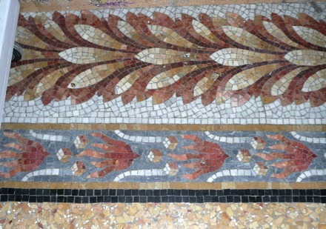
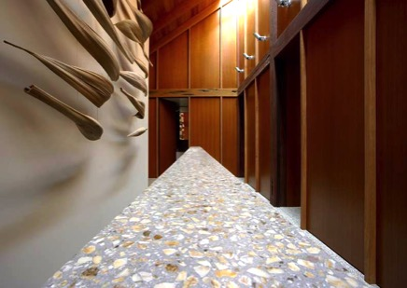
Terrazzo In-Situ

Slide 25
Training Program Proposal
Core Units
• Work effectively and sustainability in the construction industry
• Outline history of terrazzo and materials
• Plan and organise work
• Conduct workplace communication
• Carry out measurements and calculations
• Read and intent plans and specifications
• Apply basic levelling procedures
• Apply occupational health and safety requirements policies and
procedures in the construction industry

Slide 26
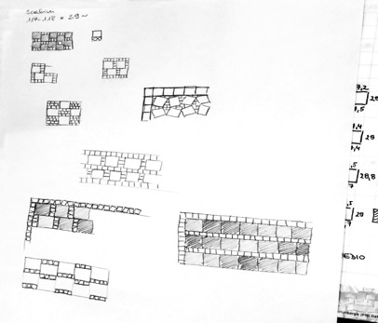
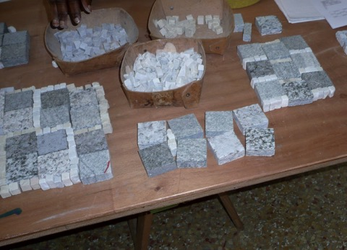
Design & Layout

Slide 27
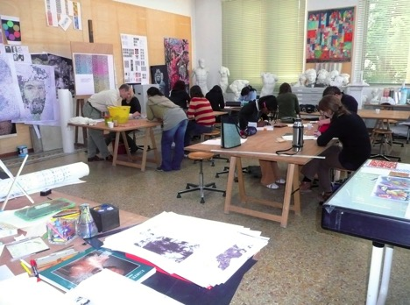
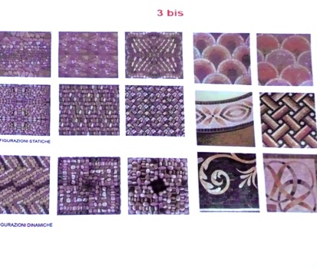
Design & Layout

Slide 28
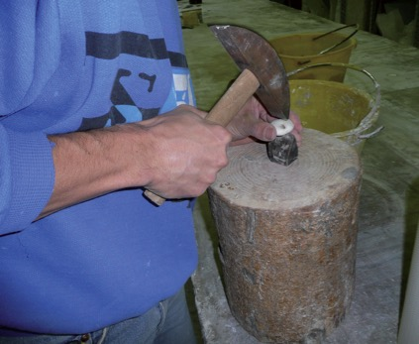
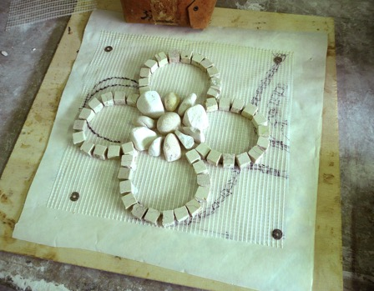
Design & Layout

Slide 29
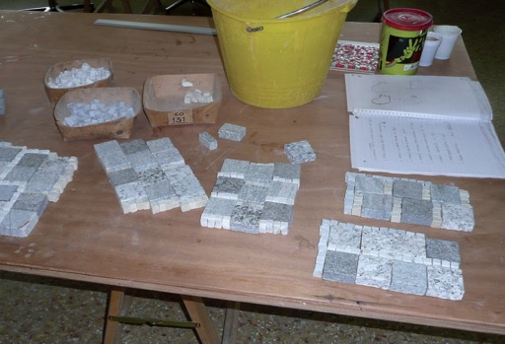
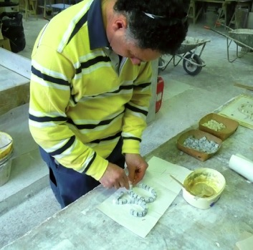
Design & Layout

Slide 30
Training Program Proposal
Terrazzo Field of Work Skills
• Handle terrazzo materials
• Basic geology
• Use terrazzo tools and equipment
• Prepare surfaces for application of terrazzo
• Place terrazzo
• Carry out repair and rectification of terrazzo pavements in situ
• Design terrazzo in situ
• Place brass/aluminium angles and design
• Place control joints, construction joints

Slide 31
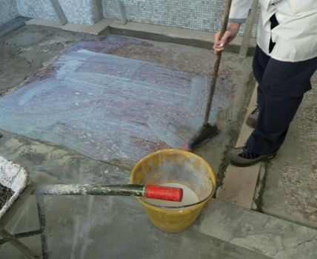
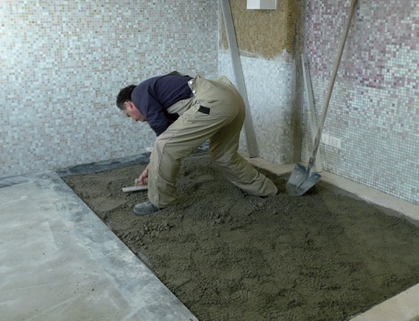
Preparation of Floor

Slide 32
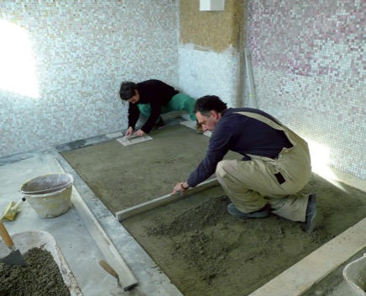
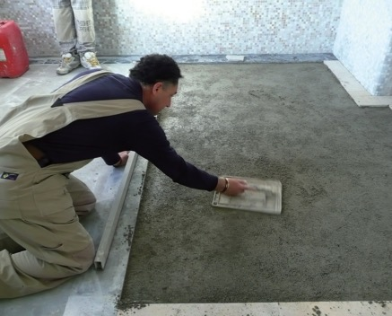
Placing a concrete base flat, straight to 25mm below finished level
Floating the concrete base to a coarse finish

Slide 33
Training Program Proposal
Specialist Terrazzo Field of Work Skill
• Production of terrazzo tiles
• Handle terrazzo tiles
• Use terrazzo tools and equipment for cutting tiles
• Prepare surfaces for terrazzo tile installation
• Apply waterproofing process to internal wet areas
• Place terrazzo tiles in mortar/ adhesive direct
• Grouting terrazzo tiles
• Polish terrazzo tiles
• Apply sealer to terrazzo pavements

Slide 34
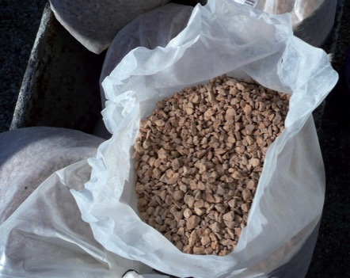
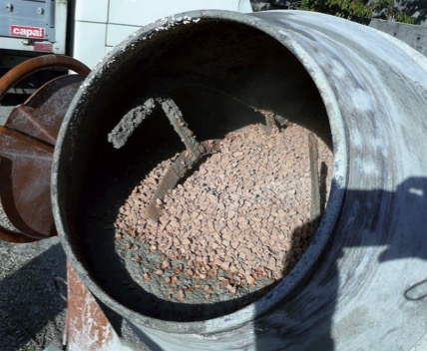
There are a variety of sizes and colours of marble chips and other durable aggregates
Mixing of marble chips and material

Slide 35
Training Program Proposal
Specialist Field of Work Skills (2)
• Terrazzo Tiles
• Grouting terrazzo tiles/ terrazzo in situ
• Use grinding and polishing tools and equipment
• Applying sealer to tiles/ in situ or in tiles.

Slide 36
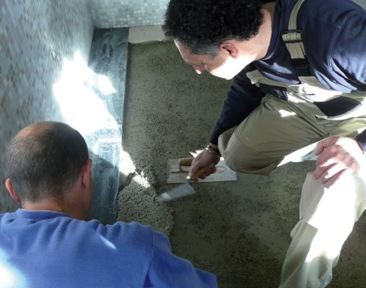
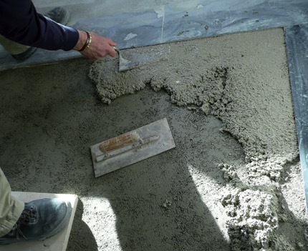
Placing of terrazzo in situ

Slide 37
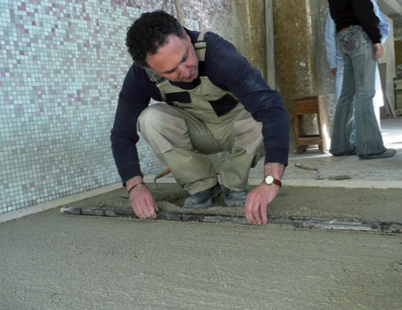
Placing of terrazzo in situ
Placement of decorative patterns

Slide 38
Placement of decorative patterns

Slide 39
Seeding
Seeding – aggregates of different colours and sizes

Slide 40
Rolling and beating, Rolling ensures the aggregates are fully embedded in the mix and are fully coated in the cement matrix, so as not to dislodge the aggregates when the terrazzo is cut and polished with machines.

Slide 41
Rolling & Beating

Slide 42
Another form of rolling using a vibratory roller to bring up and immerse the cement matrix surrounding the aggregates.
Once rolled and beaten the webbing from the pattern is removed.

Slide 43
Training Program Proposal
Specialist Field of Work Skills (3)
• Restoration of terrazzo pavements
• Research product
• Undertake analysis of materials
• Carry out testing and analysis of existing material and colour in order to
produce samples
• Prepare surfaces for terrazzo in situ
• Place terrazzo in in situ
• Polish and grind pavement to required finish

Slide 44
Final finish and curing of the terrazzo floor

Slide 45
Training Program Proposal
Elective units
• Handle concreting materials
• Use concreting pools and equipment
• Place concrete
• Finish concrete

Slide 46
Example of a terrazzo pavements near completion

Slide 47
Example of a final terrazzo pavement

Slide 48
Example of a final terrazzo pavement

Slide 49
Example of a final terrazzo pavement

Slide 50
Terrazzo Restoration
Project: Horsham Town Hall Terrazzo Floor
• Constructed in 1938 and listed on the Victorian Heritage Register in 2011
• Horsham Town Hall and Horsham Regional Art
• Extensive restoration work to the Terrazzo floor
• Original materials were largely unavailable
• Sourced materials from local and intestate suppliers
• Utilising techniques used in the original Terrazzo installation
• Results were exceptional

Slide 52
Terrazzo Tiles

Slide 56
Terrazzo In Situ

Slide 60
Thank You
www.psipavements.com

