Slide 1
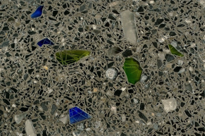
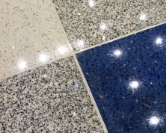
TERRAZZO
Process – Evolution of Design – Delineation – Construction
“The role of an architect”
NTMA – 94th Annual Convention

Slide 2
Coover Clark
Edward Balkin – Director of Design

Slide 3
Plan for today!!!
COOVER CLARK – Who we are?
PROCESS – What architects do?
EVOLUTION -Concept to Reality
DELINEATION – What we speak to?
CONSTRUCTION – How we get it done?
Closing thoughts

Slide 4
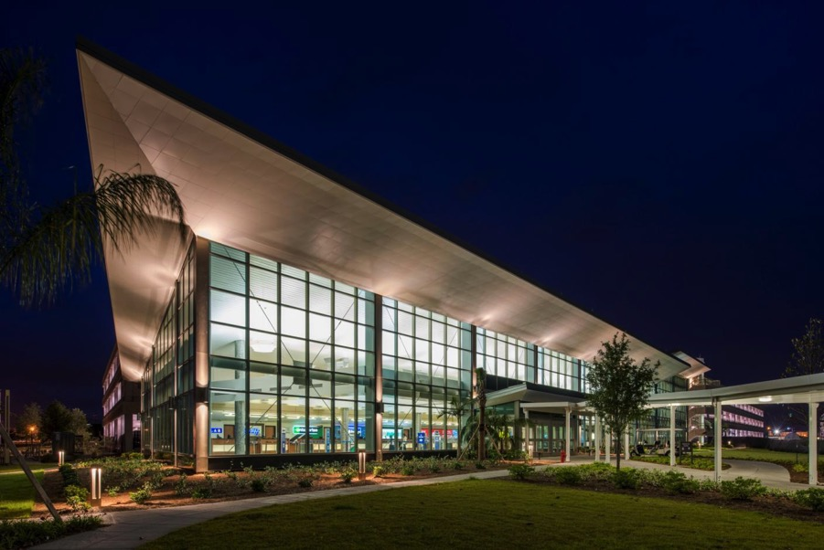
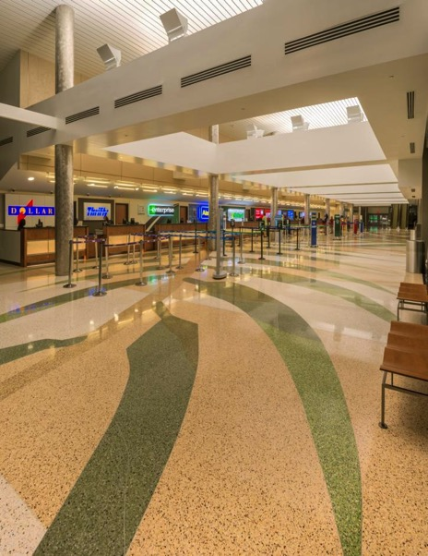
About CooverClark - Aviation

Slide 5
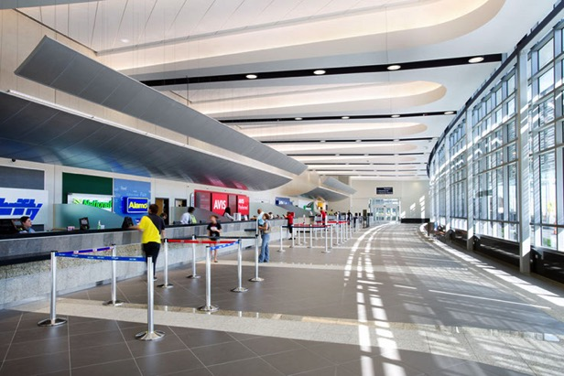
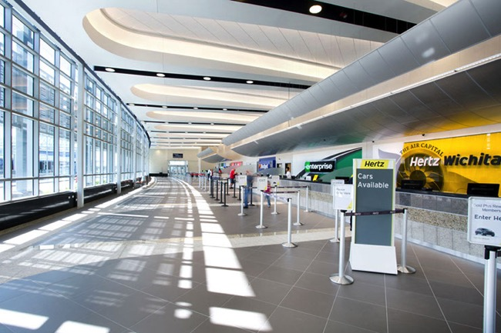
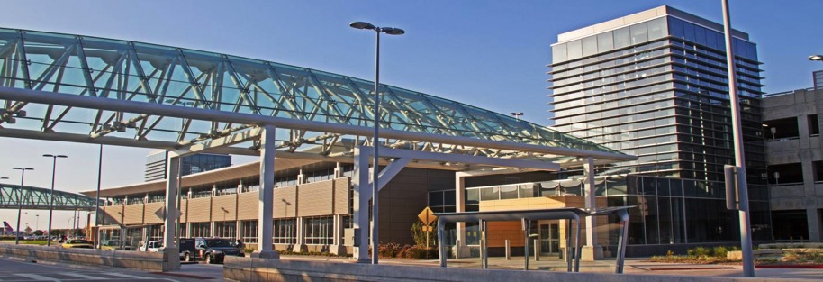
Aviation

Slide 6
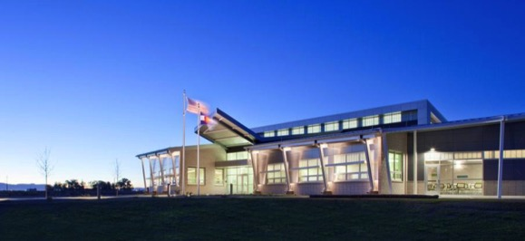
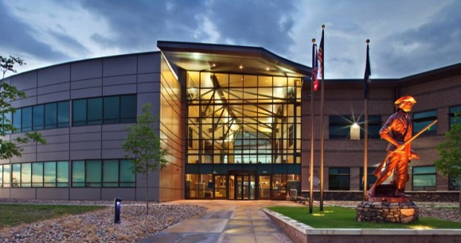
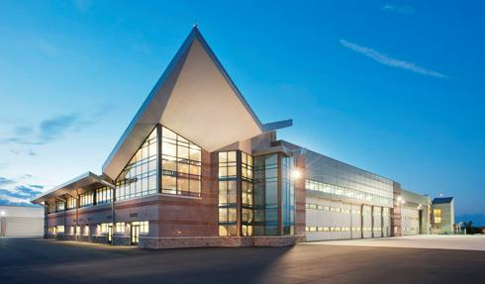
Other Project Experience
Readiness Centers
Headquarters / Administration
Access Control
Aviation
Education / Training Centers
Maintenance / Public Safety
Military Intelligence
Housing / Dining
Campus Master Plans

Slide 7
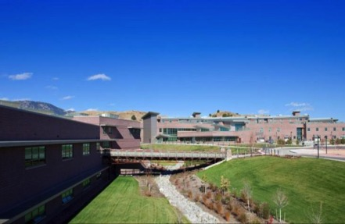
Architecture / Planning / Landscapes / Interiors / FF&E
Specialize in National Guard design projects Nationwide, 12 readiness centers
30 Airports
32 LEED certified projects in process or completed on projects up to $100M
Net Zero – Platinum – Gold - Silver – Certified – High Performance
What Makes us Unique: DESIGN!!!!!!!
Emphasis on operational efficiency/flexibility
Emphasis on timeless recruitment & retention
Design to cost/BIM technology to assure award
Practical LEED applications
Award-winning sustainability and design
Principals involved in every project /
On site availability

Slide 8
Definition “ARCHITECTURE/ARCHITECT”
Full Definition of architecture
1 : the art or science of building; specifically : the art or practice of designing and building structures and especially habitable ones
2 a : formation or construction resulting from or as if from a conscious act <the architecture of the garden>b : a unifying or coherent form or structure <the novel lacks architecture>
3 : architectural product or work
4 : a method or style of building
5 : the manner in which the components of a computer or computer system are organized and integrated

Slide 9
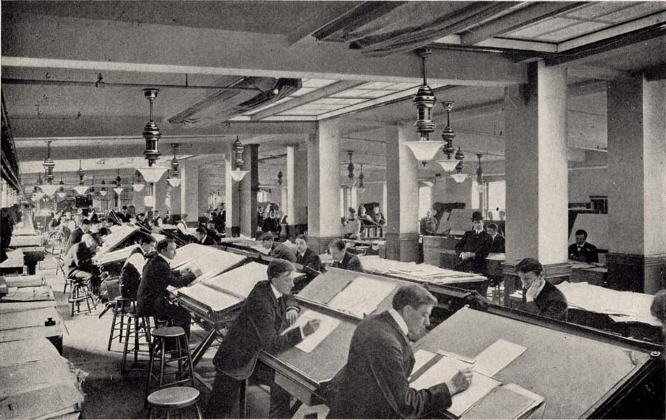
Architects office from the past

Slide 10
Offices – present – “collaboration” with consultants and clients = BEST DESIGN

Slide 11
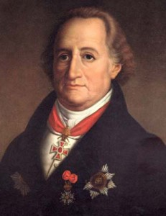
Romantic Definition of “Architecture”
Johann Wolfgang von Goethe
“Music is liquid architecture; Architecture is frozen music.” Goethe elaborated, by suggesting that architecture produces the same “tone” or effect in your mind as music.

Slide 12
Projects
Kansas City International Airport
Louis Armstrong International Airport
Denver International Airport (Concourse “C” Expansion
Minot International Airport
Space Battalion – Colorado National Guard @ Ft. Carson (in design)

Slide 13
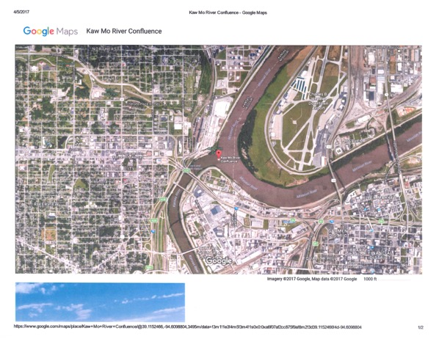
MCI – Kansas City International Airport
Convergence of the Missouri and Kaw Rivers
Winner NTMA Job of the year

Slide 14
Plan

Slide 15
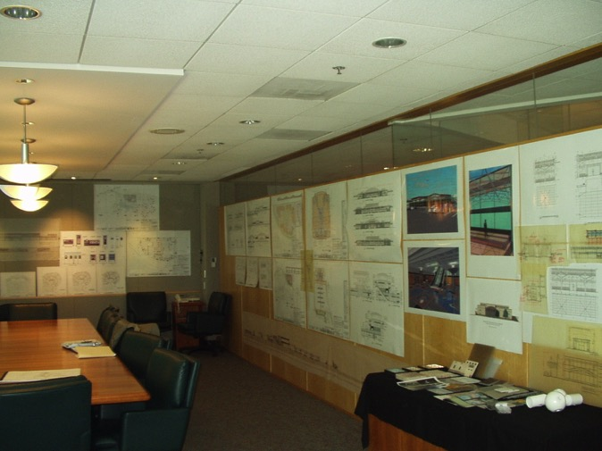
MCI – design sketch

Slide 16
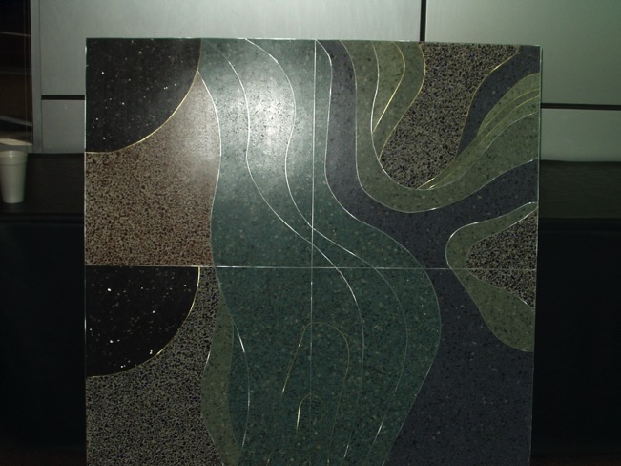
Mock-up

Slide 17
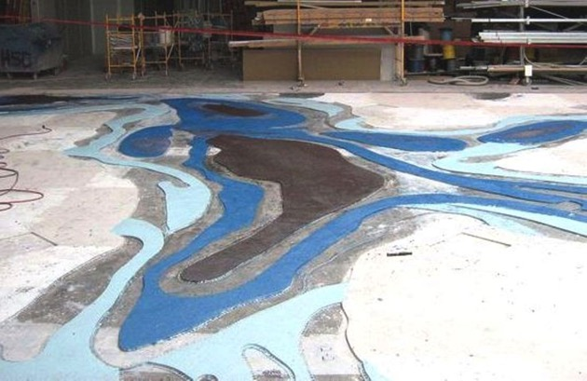
Construction

Slide 18
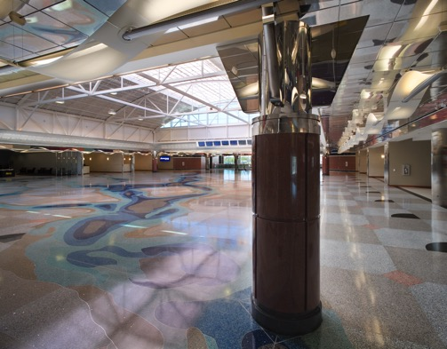
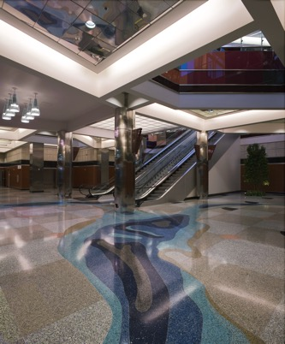
Completed Project

Slide 19
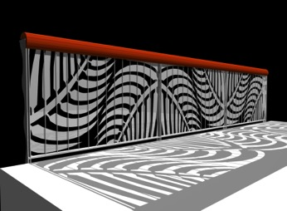
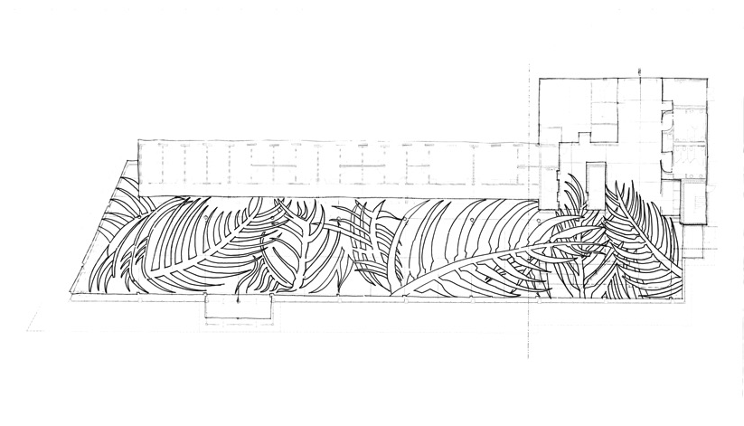
Louis Armstrong International Airport (MSY) “design concept”

Slide 20
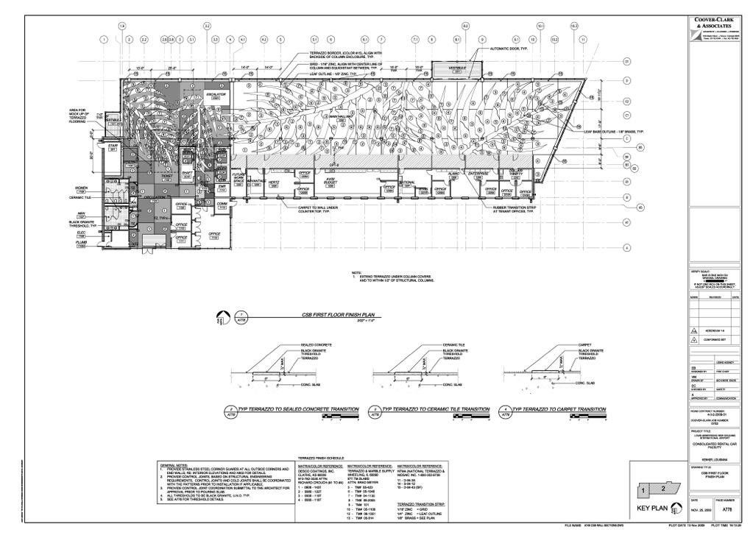
MSY – Construction Document

Slide 21
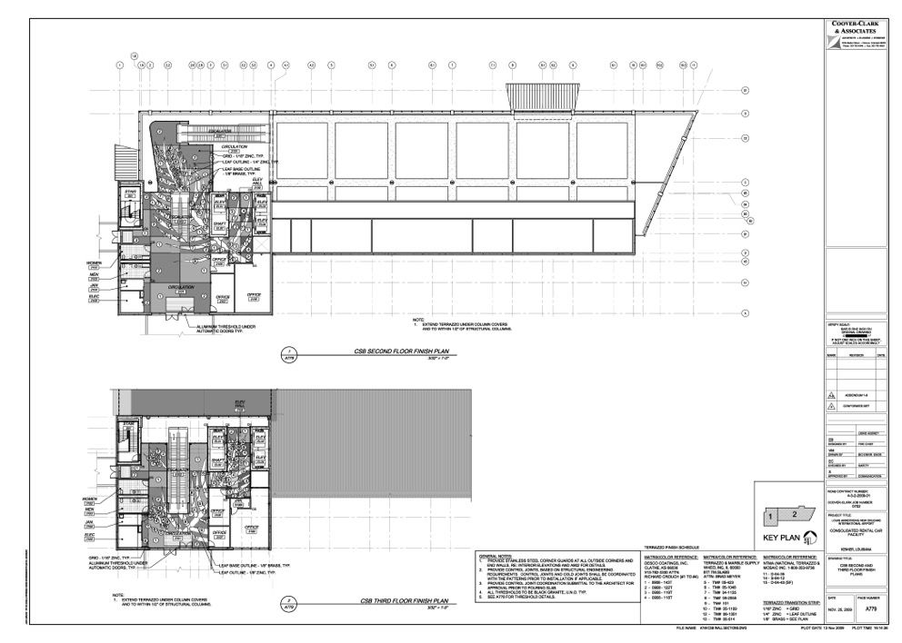
MSY – Construction Document

Slide 22
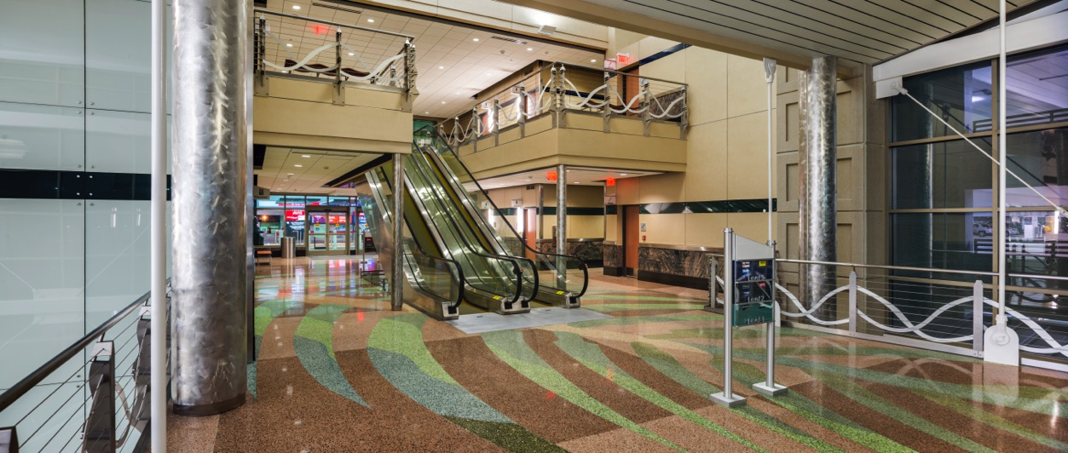
MSY

Slide 23
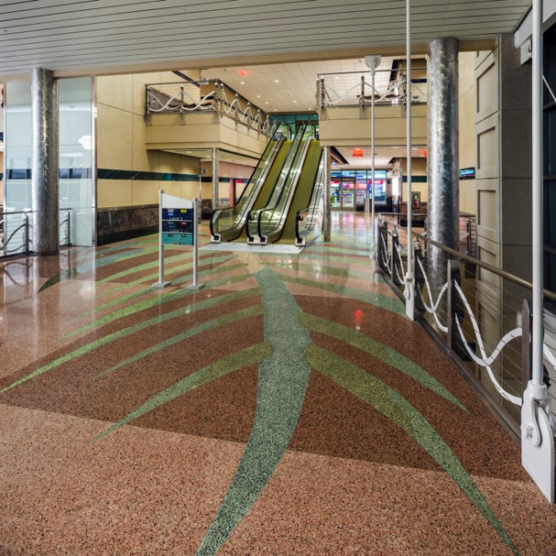
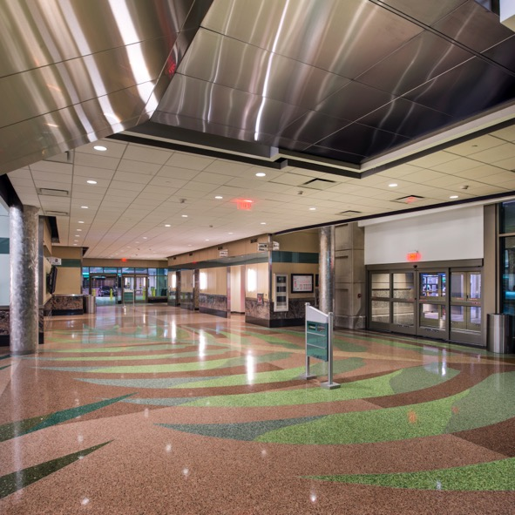
MSY

Slide 24
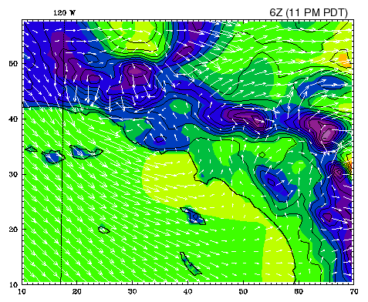
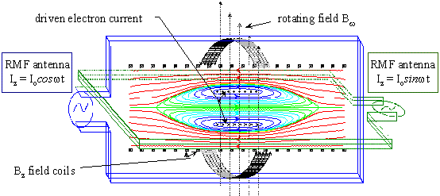
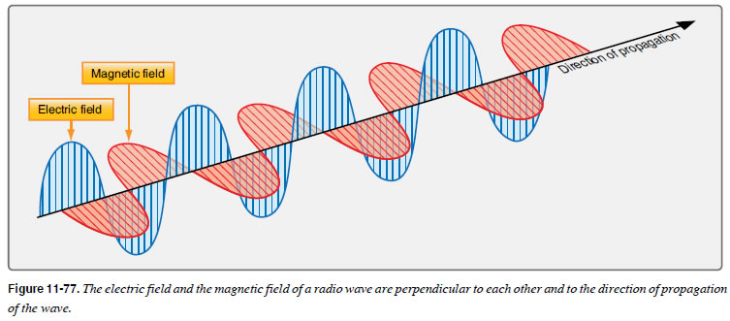
Denver International Airport- DEN Concourse “C” Expansion

Slide 25
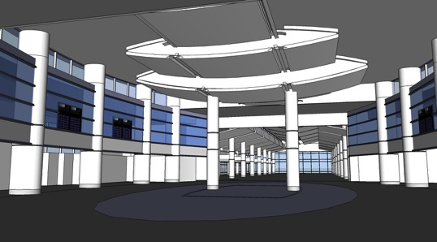
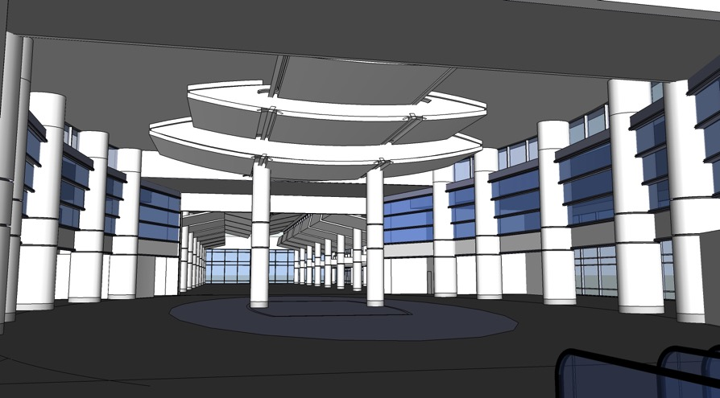
DEN – Studies (form)

Slide 26
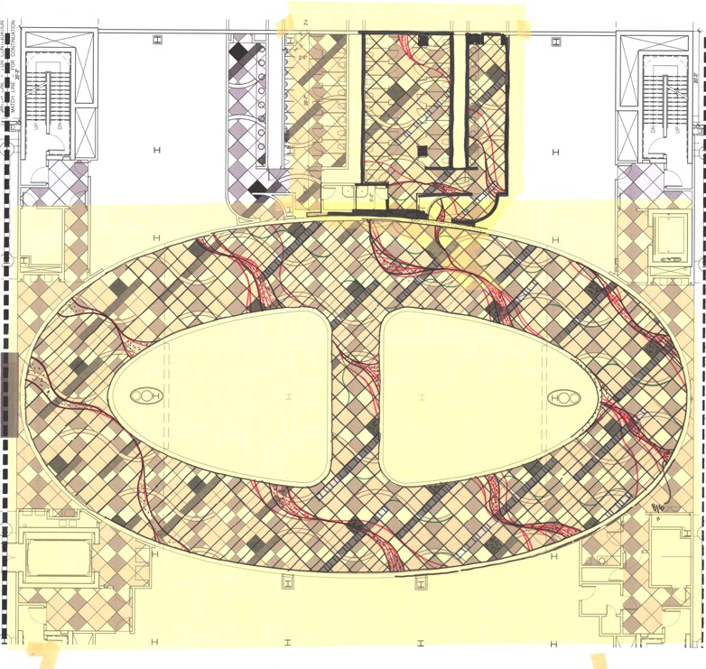
DEN – “Concept sketch”

Slide 27
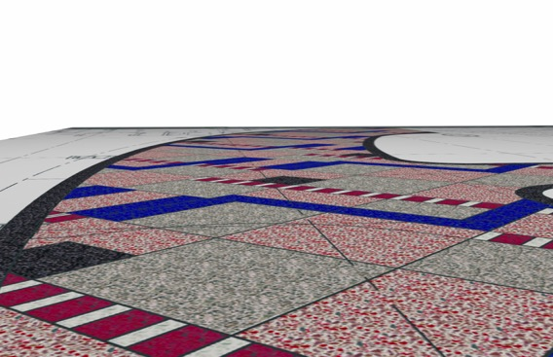
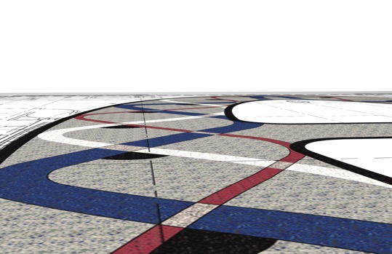
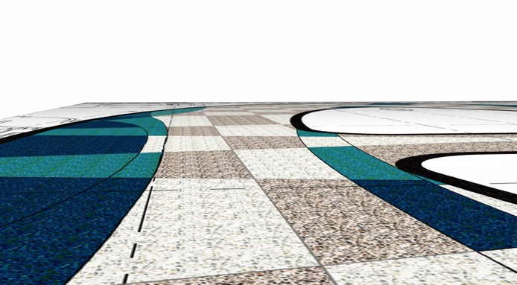
DEN – studies; floor

Slide 28
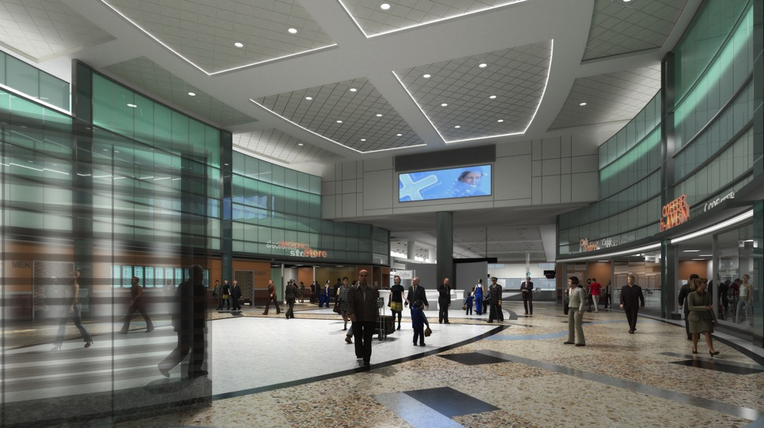
DEN - rendering

Slide 29
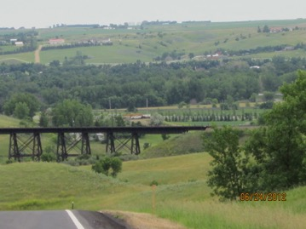
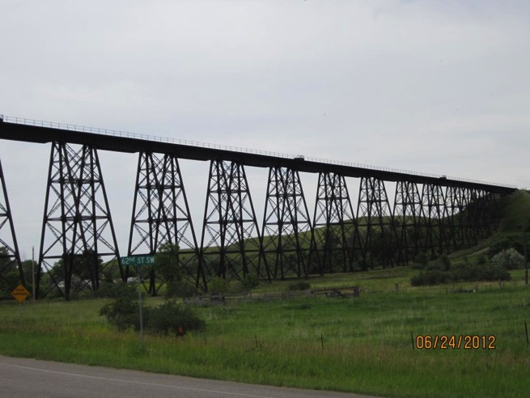
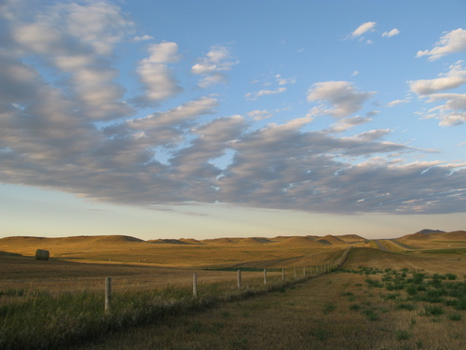
Minot International Airport – MOT “concept images” – The Magic City

Slide 30
MOT – “concept images”

Slide 31
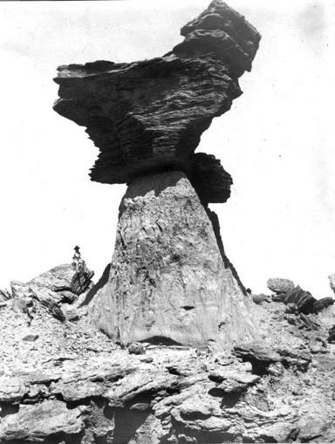
MOT – “concept images”

Slide 32
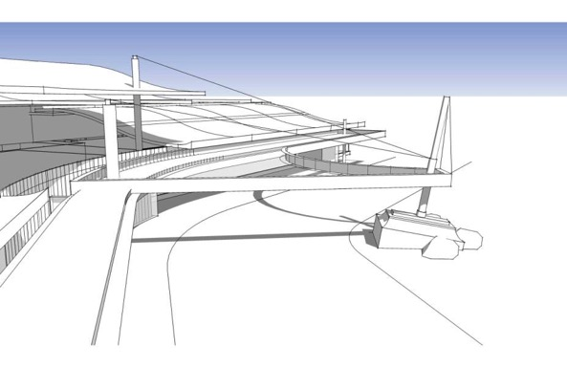
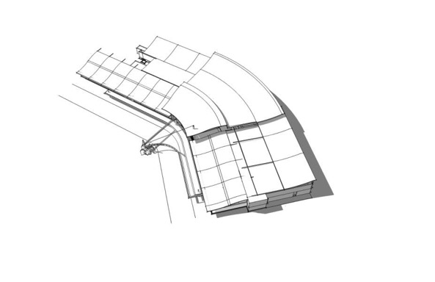
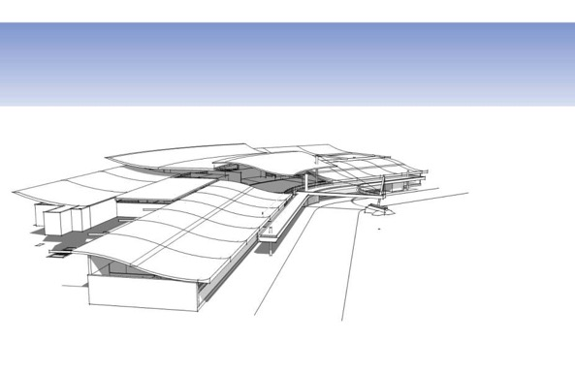
MOT – “architecture”

Slide 33
Terrazzo – “concept”

Slide 34
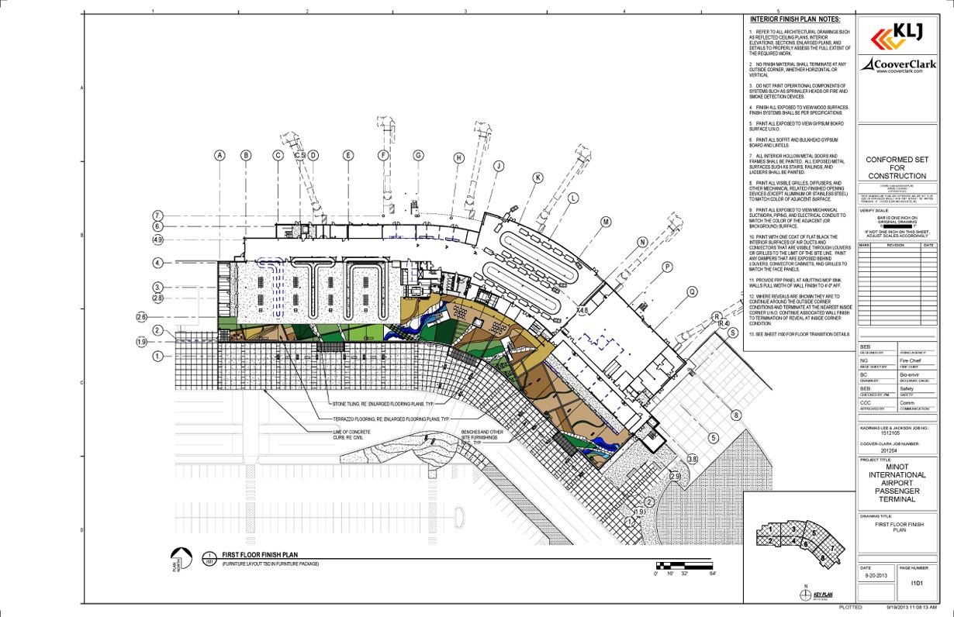
Terrazzo – Construction Document

Slide 35
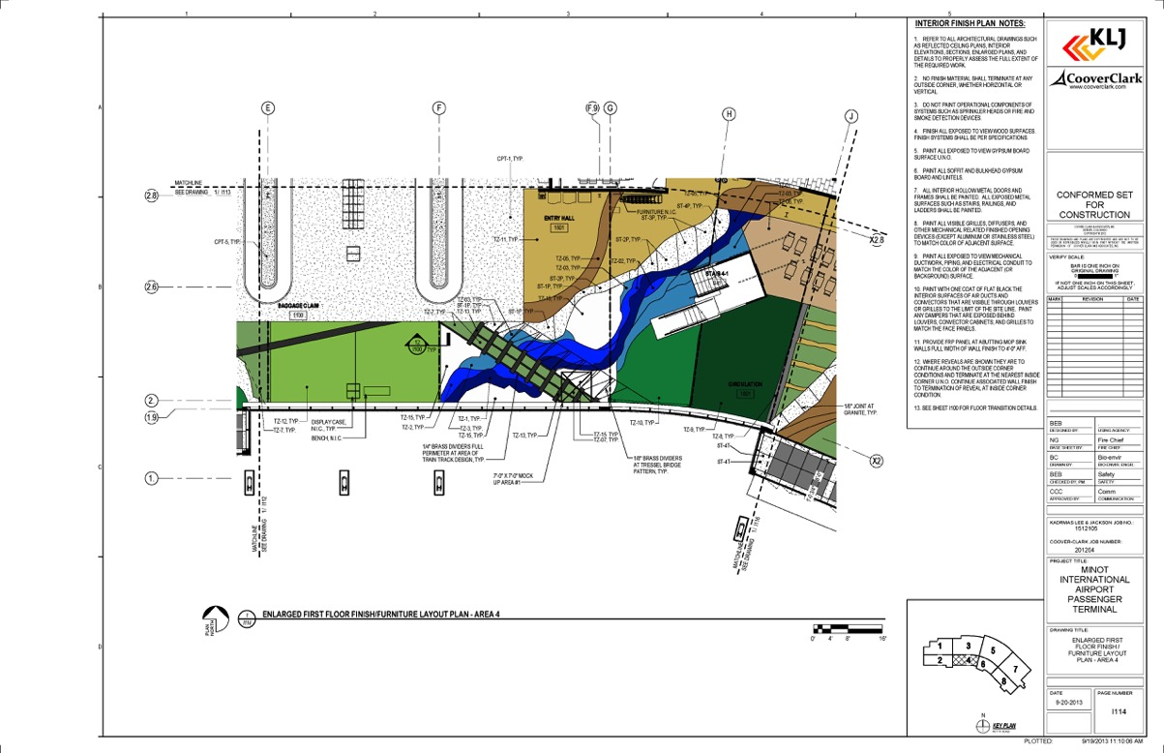
Terrazzo – Construction Document

Slide 36
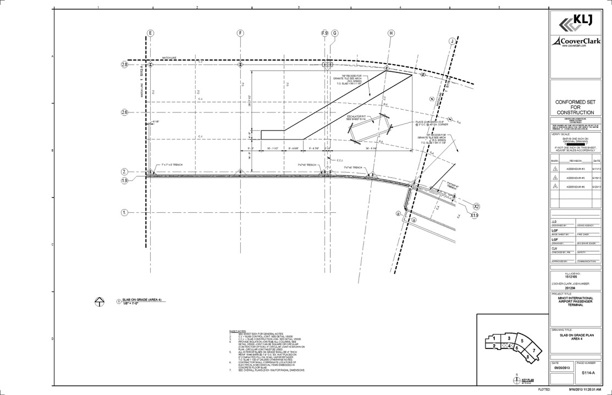
Terrazzo – Construction Document STRUCTURAL

Slide 37
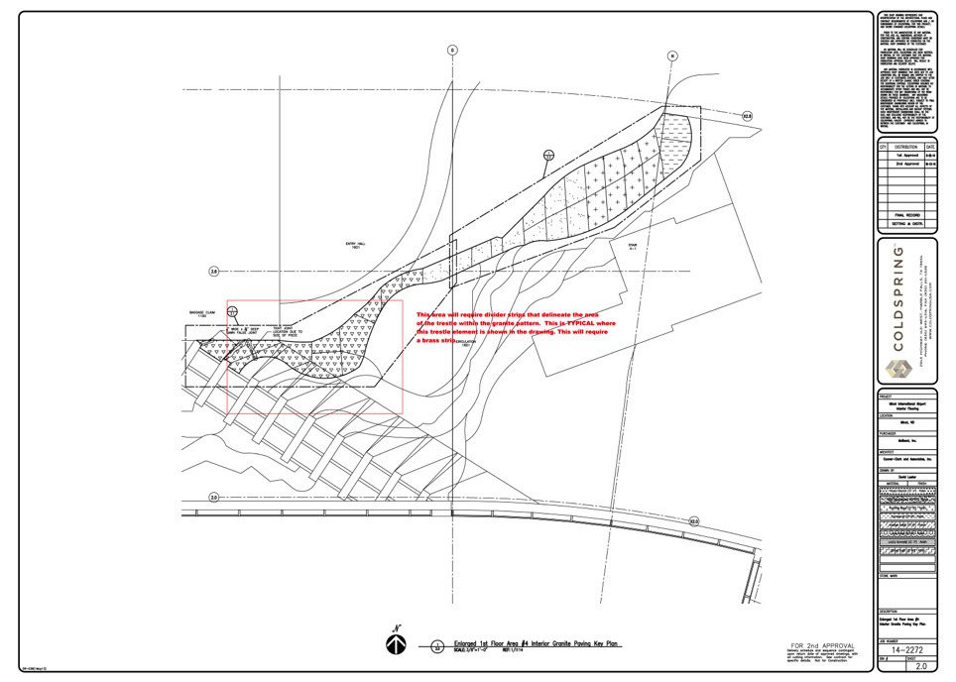
Terrazzo – Construction Document GRANITE SHOP DRAWING

Slide 38
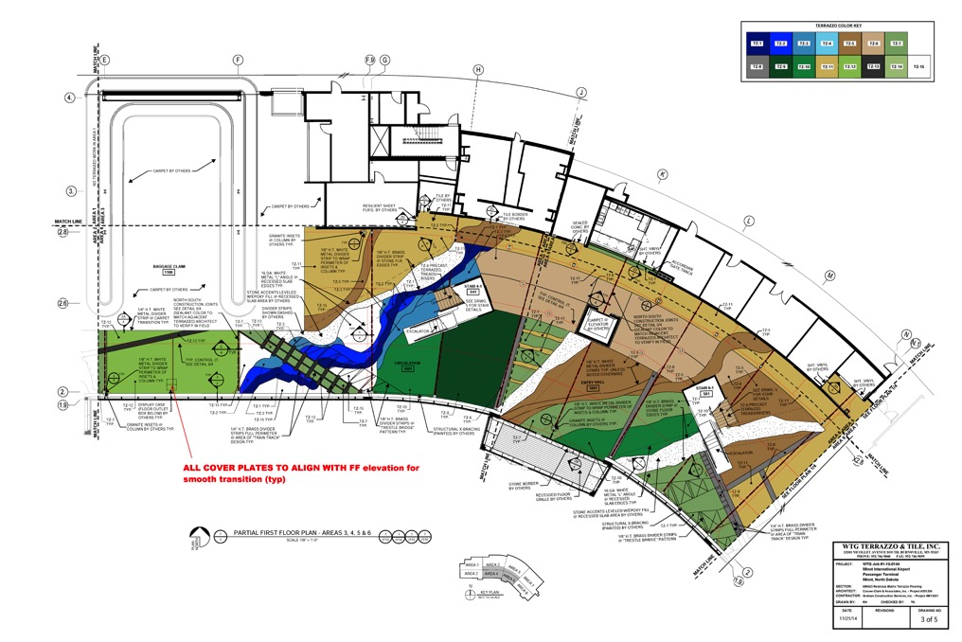
Terrazzo – Construction Document TERRAZZO SHOP DRAWING

Slide 39
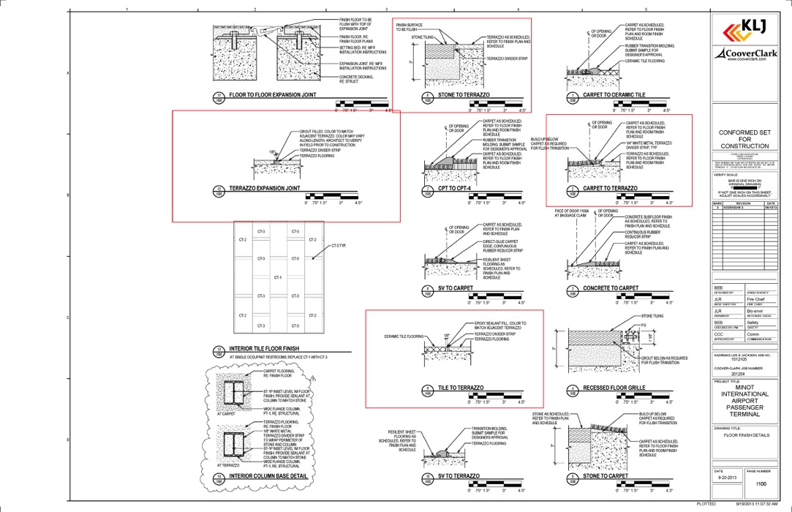
Terrazzo – Construction Document DETAILS

Slide 40
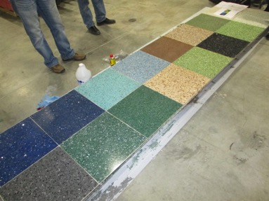
Terrazzo – Mock-up @ fabricator

Slide 41
Terrazzo – “Story Board”

Slide 42
MOT

Slide 43
MOT

Slide 44
Space Battalion – Ft. Carson (in design)

Slide 45
Space Battalion – “concept”

Slide 46
Pre-Construction

Slide 47
Pre-Construction

Slide 48
Discussion
How we sell terrazzo to clients
Specifications
Waterproof membrane – add to ALL jobs!
Grit – how to determine grit in the spec for maintenance
How to maintain terrazzo – list of requirements for the client – NO SURPRISES!
Heated slabs – additional info!

Slide 49
Discussion (cont.)
Dividers – how to draw and specify them – how to elaborate on divider joints
Cold temp. construction and the negative effect of propane
How to determine sequence when using “other” materials in the floor
Moisture content of slab - specifications

Slide 50
Conclusion
ter·raz·zo
[təˈräzō, təˈrätsō]
flooring material consisting of chips of marble or granite set in concrete and polished to give a smooth surface.

Slide 51
9,000–8,000 BC to present – Josh, Bob, Chris, Scott, Rick, Darin, Leslie, Mark

